Slide 1
PROJECT PRESENTATION
ONLINE SALES DATASET

Slide 2
DESCRIPTION ABOUT DATA
The Online Sales Dataset contains transactional data collected from an e-commerce platform. It records details of customer purchases made through an online website over a specific time period. The dataset helps analyze sales performance, customer's review rating and product demand
PROCESS
First we can checked the information of the dataset regarding their feature,datatype and null value.
Checked the unique features
Checked duplicates for the features.
EDA-In this process we segemented and segregated the features and framed questions.
After segmentation we grouped the questions accordingly, we visualizad for better understanding.

Slide 3
WORKFLOW OF DATA ANALYSIS
* COLLECTION OF DATA
* UNDERSTANDING DATA AND BUSINESS PROBLEM
* DATA CLEANING
* DATA TRANSFORMATION
* EXPLORATORY DATA ANALYSIS
* DATA VISUALIZATION
* PRESENT FINAL INSIGHTS

Slide 4
1. collection of data
Collected this data from kaggle by checking their rows,columns and null values.
Downloaded in CSV format .
2.UNDERSTANDING DATA AND BUSINESS PROBLEM
The dataset includes cutomers personal details like Cutomer_id , State and Country
It contains product information like Product_Category, Product_Name, Quantity, Total_Sales_INR,
Unit_Price_INR
Payment details like Payment_Method, Delivery_Status, Review_Rating,Review_Text
3.SUMMARY OF FEATURES
The online sales dataset consists of various features that capture complete information about e-commerce
transactions. It includes order details such as order ID and order date, customer information like
customer ID and location, and product-related attributes including product ID, product name, and product
category. The dataset also contains numerical features such as quantity sold, unit price,
total sales amount, which help in analyzing revenue and business performance. In addition, categorical
features like payment method and order status provide insights into customer preferences and
delivery outcomes.

Slide 5
data cleaning
Checked for null values No null values # dfname.isnull()
Checked for duplicates No duplicates # dfname.duplicated.sum()
(ordered id & cutomer id)
Checked for unique features each has it’s own unique # dfname.unique()
Checked rows and columns ROWS-15000 COLUMNS-13
Reviewed column names and data types
data transformation
Dataset prepared for analysis.
Features made easier to understand and compare.
Ready for visualization and further analysis.

Slide 6
exploratory data analysis
To understand data patterns & trends.
Improve the sales performance by customers review rating and
This anaylsis Transaction records , Payment method &which product sales highest
segmentation analysis
CUSTOMERS BASED ANALYSIS
PRODUCT BASED ANALYSIS
PAYMENT BASED ANALYSIS
REGION BASED ANALYSIS
DATE WISE ANALYSIS

Slide 7
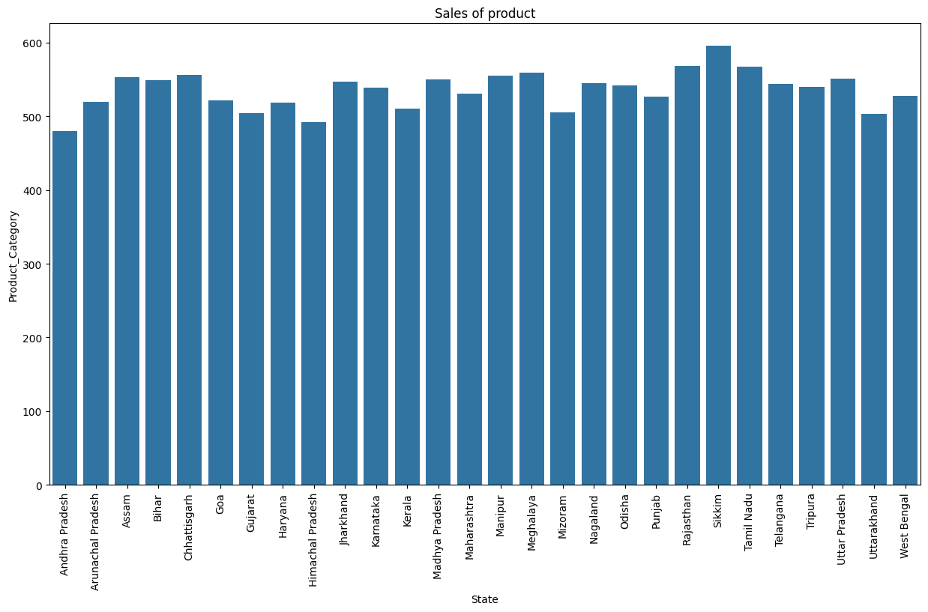
CUSTOMERS BASED ANALYSIS
In that 28 state Sikkim has the highest product sales at about 596 ,followed by Rajasthan has the second
Highest product sales at about 568 and Others are average between 500 to 550 . Andhrapradhesh has
Least product sales at about 480

Slide 8
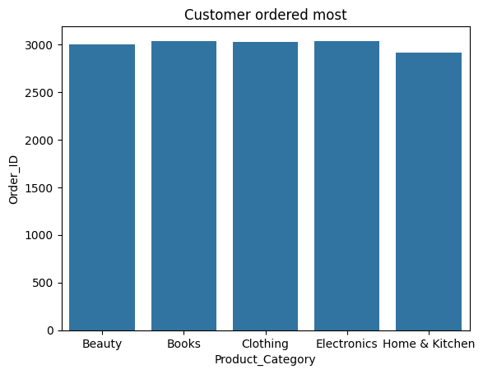
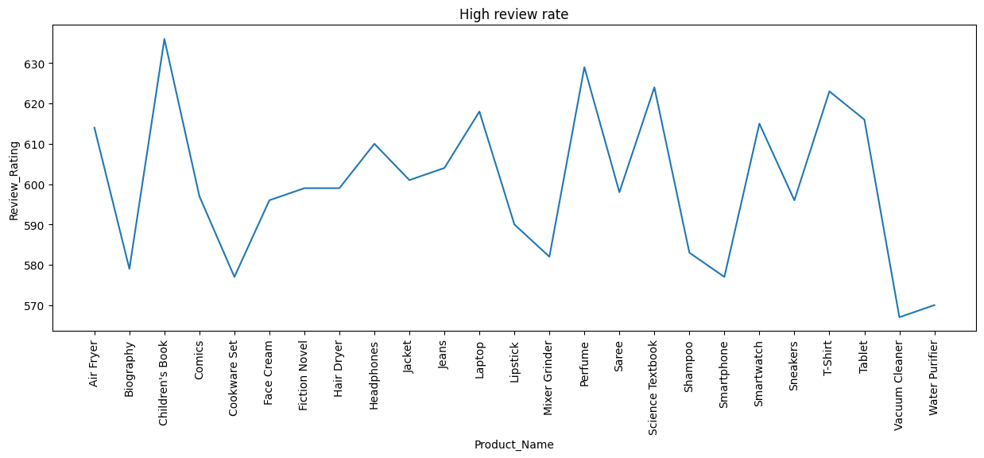
PRODUCT BASED ANALYSIS
In that 5 product Electronic product
has most ordered by cutomers at about 3036,
Followed by Books has also most ordered by
Customers at about 3035, Beauty product has ordered
About 2995,Clothing product has ordered at about
3022,Home&Kitchen product has least ordered by
Customer at about 2910
Children's book has the highest review rate at about
636, Vacuum cleaner has the most lowest review rate
At about 567 ,Others are average between 570 to 620

Slide 9
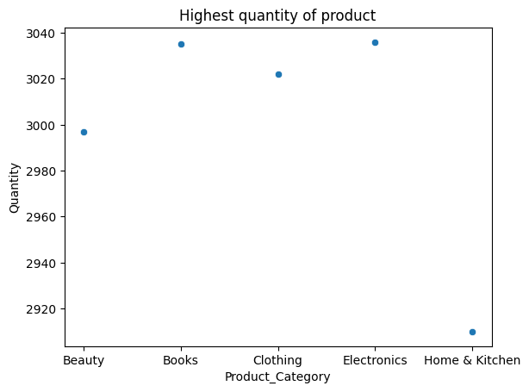
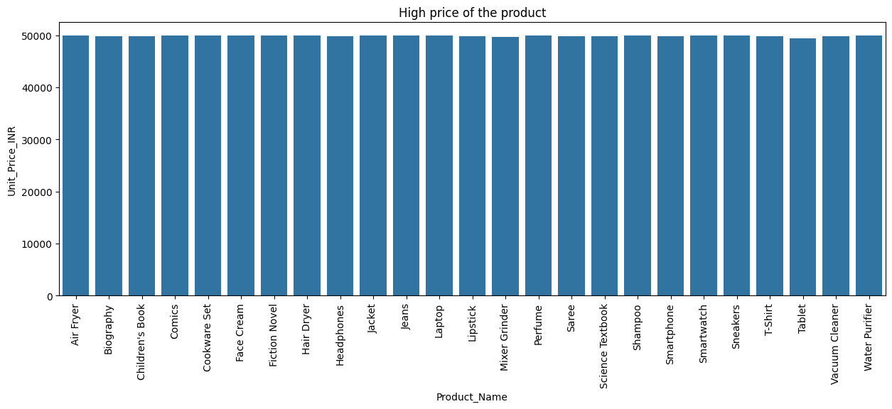
Books and Electronics have highest quantity
Of product at about 3036 & 3035,Beauty product
Has about 2997,Clothing product has about 3028,
Home&Kitchen product has 2910.
Sneakers has highest unit price at about 49994.43,
Waterpurifier also have high unit price compare to
Others at about 49991.10, Mixer grinder has most
least unit price at about 49664.09

Slide 10
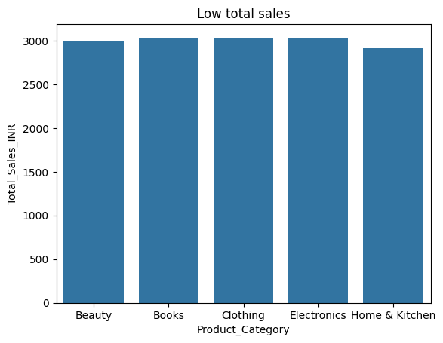
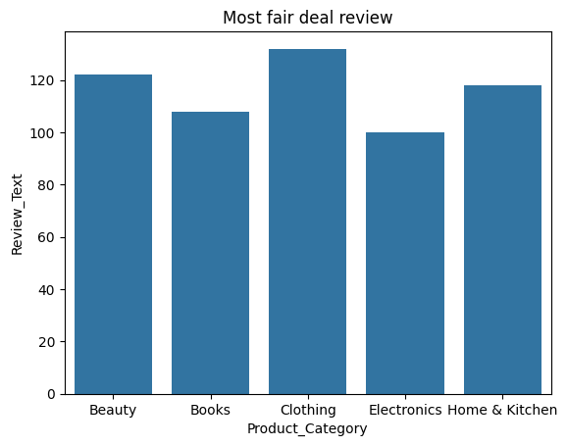
Home & Kitchen has the lowest total sale at
About 2910,Electronics has highest total sale at
About 3036.
Clothing product has the most fair deal at about 132
Review text,Electronics product has least fair deal at
About 100 review text,Books has about 108 review text ,
Beauty product has about 122 review text, Home&Kitchen
Has about 118 review text

Slide 11
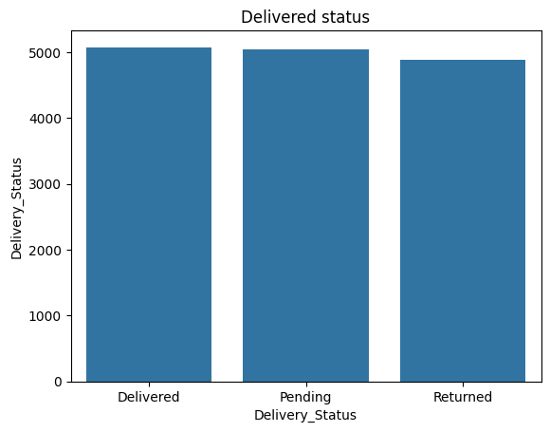
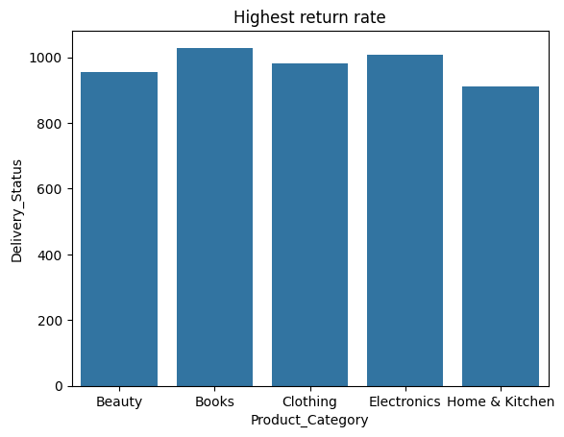
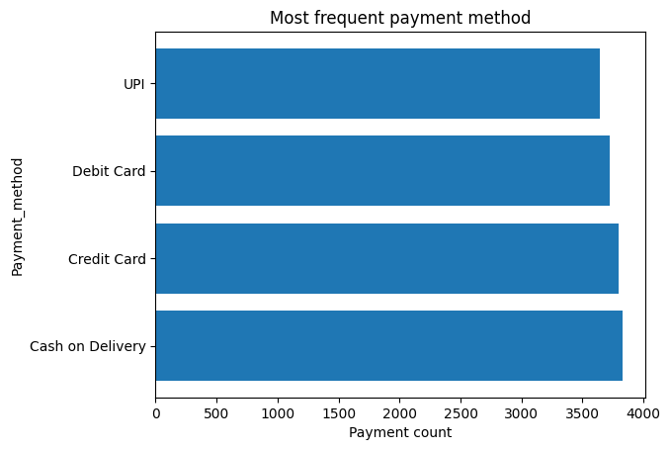
PAYMENT BASED ANALYSIS
* 5075 Product has delivered
* 4881 product has returned
* 5044 product has pending
1029 Books were returned
Second highest 1006 Electronics were returned
* Most frequent payment method is cash on delivery at 3827
* 3800 Customer pay through credit card
* 3727 Customer pay through debit card
* 3646 Customer pay through upi

Slide 12
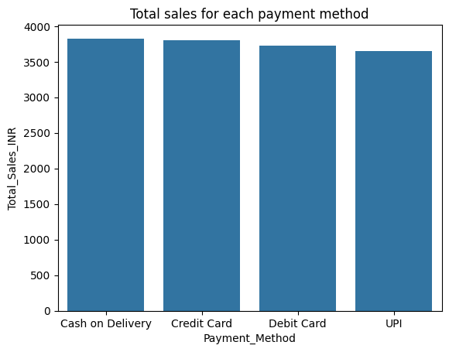
Cash on delivery has the high total sales at 3827
Credit card has the second largest total sales
compare to others at 3800,UPI has least total sales at
3646

Slide 13
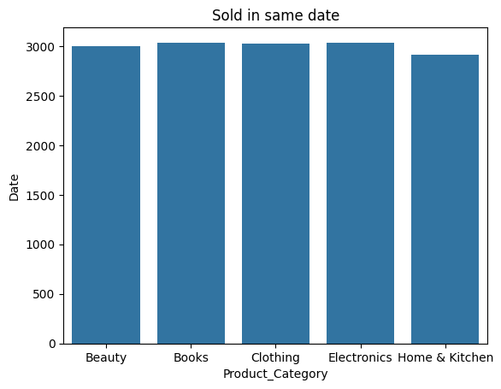
DATE WISE ANALYSIS
* 2997 Beauty Product can sold in same date
* 3035 Books product can sold in same date
* 3022 Clothing product can sold in same date
* 3036 Electronic product can sold in same date
* 2910 Home & Kitchen product can sold in same date

Slide 14
pRESENT FINAL INSIGHTS
Sikkim State has the highest product sales at about 596
Electronic product has ordered most at about 3036
Children's book has the highest review rate at about 636
Compare to others Books(3035)and Electronic(3036) thus customer ordered highest
Sneakers has highest unit price at about 49994.43
Home & Kitchen has the lowest total sale at about 2910
Clothing product has the most fair deal at about 132
577 Quantity of clothing product has sold
625 Home & Kitchen product has above 5 review rate
3646 customers can purchase the product through upi
5075 Product has delivered and 4881 product has returned
653 products are excellent review rate
954 Beauty product has return
1029 Books were highest return rate
Most frequent payment method is cash on delivery
Cash on delivery has the high total sales
12 Lipstick product can delivered in sikkim state
553 product has sold in Assam
115 Electronic product has sold in Tamilnadu

Slide 15
THANKYOU

